Slide 1
Immersive Systems
NSERC Engage Grant Slides
April 4th, 2014

Slide 2
Team
Dr. Shahram Payandeh
Cliff Edwards
Soheil Keshmiri, Postdoctoral fellow
George Xu, Graduate student
Timofey Nosov, Undergraduate student

Slide 3
Initial Problem
Create a platform where players can play a multiplayer game using teleoperated robots over the web

Slide 4
Expanded Problem
Expand to a cloud platform for hobbyist robots
Can still be used for multiplayer robot gaming
Currently, there is a technical hurdle to connect robots to the internet and even then, there is nothing interesting online once the robots are connected

Slide 5
Applications and Markets
Multiplayer robot gaming
Gamers
Teleoperation over the web
Hobbyist Roboticists
Social sharing of robots
Hobbyist Roboticists
STEM Education
Participants in STEM Education

Slide 6
Solution
Arduino robots with a Raspberry Pi will communicate with our server platform using an API
Robots will send information about itself and its surroundings to server
Server will collect information from other robots, operators and environment information and send it to the robot

Slide 7
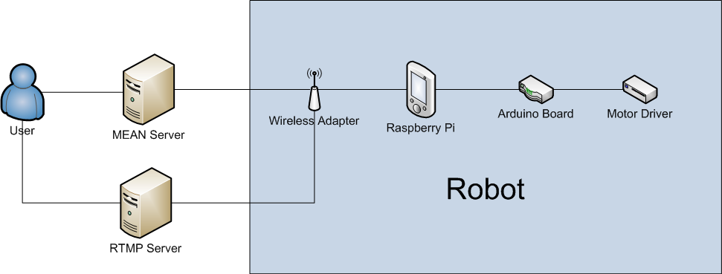
Infrastructure

Slide 8
Robots
Typically robots include an Arduino board, motor driver, motors, chassis and battery
We add a Raspberry Pi, USB hub, wireless adapter, webcam
Additional add-ons can include a gripper and pan-tilt base for the camera

Slide 9
Robots
We have two robots, one named the Lynx and the other named the Thumper
Two robots are used to demonstrate multiplayer capability of platform
Both are different designs from each other
Both can be teleoperated simultaneously

Slide 10
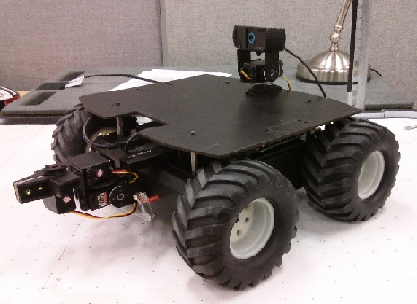
The Lynx

Slide 11
Costs of the Lynx
Parts | Price
Lynxmotion A4WD1 Rover Kit | $340
Lynxmotion Pan and Tilt Kit | $30
Lynxmotion 4WD1 Robot Gripper Kit | $75
Sabertooth Dual 12A Motor Driver | $85
Botboarduino Robot Controller | $35
Raspberry Pi with SD Card | $50
12V 5200mAh NiMH Battery | $50
25W Adjustable Switching Regulator | $30
Logitech C920 Webcamera | $95
USB Hub and Wireless Adapter | $40
Total | ~$830

Slide 12
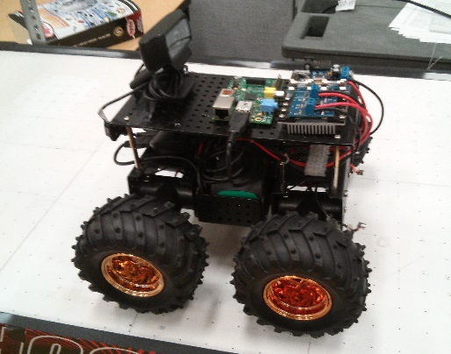
The Thumper

Slide 13
Costs of the Thumper
Parts | Price
Dagu Wild Thumper 6WD Chassis | $280
T’Rex Robot Motor Controller | $80
Raspberry Pi with SD Card | $50
12V 5200mAh NiMH Battery | $50
Logitech C920 Webcamera | $95
USB Hub and Wireless Adapter | $40
Total | ~$595

Slide 14
Cost Objective
In our submission, our goal was to create a functional reference robot for $1000 and with a stretch goal of $750
A robot without gripper arm or pan and tilt was designed for $595, a robot with these additions created for $830

Slide 15
Server and Robot Communication
Server and robots communicate using sockets
Python program on Raspberry Pi listens to the socket connection from the server
Robots can also send data back to the server using sockets

Slide 16
Robot Communication
Raspberry Pi acts as the computer, handles all the processing and communication
Commands from server sent to Pi which then sends to Arduino over serial which then sends to motors over serial through a motor driver
Arduino board has a program to control motors and servos based on commands sent from the Pi

Slide 17
Communication System
Pi has a Python socket client that receives a command message from the users via the server
Sockets are asynchronous
Pi then sends this message over serial to Arduino
Arduino has listener loop to read a message buffer
Messages that appear in the buffer are decoded into motor values

Slide 18
Video Streaming
The webcam is connected to the Pi which uploads the video stream to a RTMP media server
RTMP media server creates a video stream which can be broadcasted

Slide 19
Webcam Selection
We need to encode the video in H.264 format but the Pi is not fast enough to encode live streams
The Logitech C920 includes an onboard encoder to encode the stream for us
Field of vision on the C920 is about 78 degrees
We tried lens that increased the FOV but they were too small and blocked some of the view

Slide 20
Video Latency
In our submission, one of the main points of was to investigate stream and command latency
Commands from web server are delivered almost instantaneously to the robot (<100 ms)
Video latency is about 200 to 300 ms which is functional and fast compared to other projects

Slide 21
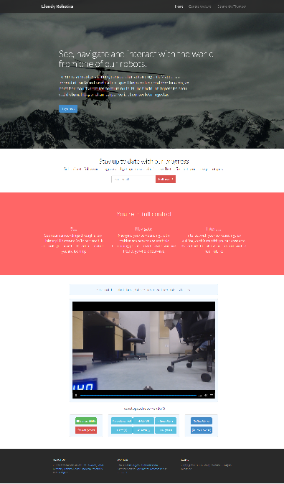
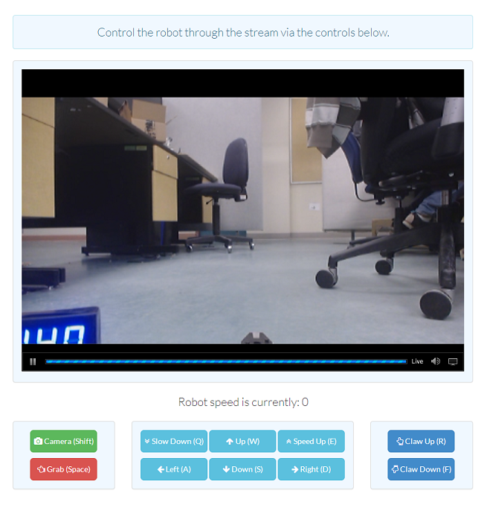
Webpage

Slide 22
User Interface and Experience
The controls are simple and can be executed by clicking on buttons or using the keyboard
Pan and tilt can be controlled using mouse

Slide 23
Robot Control
Experimented with controlling the robot like you would a car (acceleration, deceleration, steering), but found this was hard to control and the wheels on the robot can’t turn
Decided to control the robot by controlling it like you would in a game (the robot moves for as long as you hold the move key down)
Have yet to explore touch interfaces

Slide 24
User Studies and Feedback
We conducted a formal study with 10 users to investigate controls and user interface
People say robots are responsive and controls are simple to use and understand
Everyone preferred the Lynx over Thumper due to smoother motors
Would like to see higher FOV and be able to turn while moving (something we implemented)

Slide 25
Team Growth and Learning
Team headed into project with little hands-on experience with robotics
Gained experience with motors, servos, encoders, Arduino, Raspberry Pi, batteries, electrical assembly, media streaming, serial communications, socket communications, Linux systems and source control

Slide 26
Next Steps (Business)
Scheduled to talk with a local high school teachers involved in robotics
Applying for accelerators and robot competitions (SFU Venture Connection, GrowLabs, iStart RobotLaunch, etc…)
Incorporate under Cloudy Robotics with students joining as co-founders

Slide 27
Next Steps (Technology)
Migrate all code to support ROS (Robot Operating System)
Support audio streaming and also audio playback for full telepresence experience
Implement laser tag using infrared sensors

Slide 28
Thank you
Visit our GitHub repos:
https://github.com/ImmersiveSystems/net-robo
https://github.com/gmxu/mean

